Slide 1
CAPSTONE PROJECT
HOUSING PRICE PREDICTION
Presented By:
Ishwarya M
Madha Engineering College
Biotechnology

Slide 2
OUTLINE
Problem Statement
Proposed System/Solution
System Development Approach
Algorithm & Deployment
Result
Conclusion
Future Scope
References

Slide 3
PROBLEM STATEMENT
The challenge lies in handling diverse datasets, including structured data like property features and unstructured data like neighborhood characteristics, as well as accounting for factors such as economic indicators and seasonal variations. Additionally, ensuring the model's generalization to unseen data and avoiding overfitting is paramount.

Slide 4
PROPOSED SOLUTION
One proposed solution for housing price prediction is using machine learning algorithms trained on historical housing data. These algorithms can analyze various features such as location, size, amenities, and economic factors to make predictions about future housing prices. Additionally, incorporating techniques like regression analysis or neural networks can enhance the accuracy of predictions. However, it's crucial to continuously update and refine the model with new data to maintain its effectiveness.

Slide 5
SYSTEM APPROACH
A housing price prediction system typically involves gathering relevant data such as location, size, number of bedrooms/bathrooms, amenities, and historical sales prices. Machine learning algorithms, such as regression models or neural networks, can then be trained on this data to predict future housing prices based on input features. Feature engineering, data preprocessing, model selection, and evaluation are crucial steps in building an accurate prediction system. Additionally, incorporating factors like economic indicators, market trends, and demographic information can enhance the predictive power of the system.

Slide 6
ALGORITHM & DEPLOYMENT
To create a housing price prediction algorithm, you typically use machine learning techniques such as regression. Here's a simplified overview of the steps involved
1.Data Collection
2.Data Preprocessing
3.Feature Engineering
4.Model Selection
5.Model Training
6.Model Evaluation
7.Hyperparameter Tuning
8.Deployment

Slide 7
For deployment, you can consider using frameworks like Flask or Django for creating APIs, or platforms like Heroku or AWS for hosting the model. Make sure to monitor the model's performance over time and update it as needed. Additionally, ensure compliance with relevant regulations and ethical considerations, especially regarding data privacy and fairness.

Slide 8
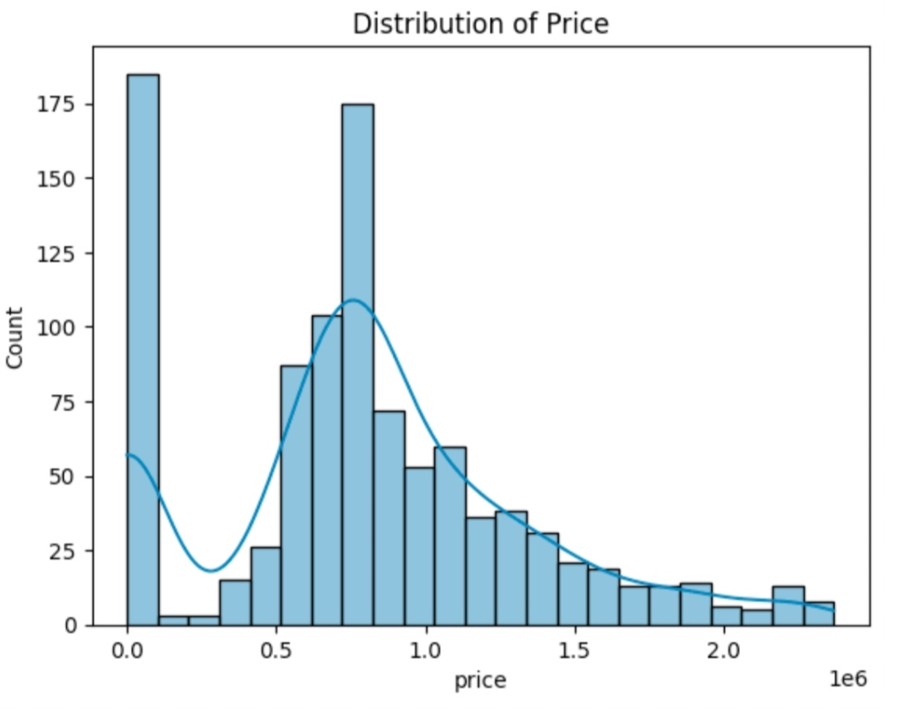
RESULT

Slide 9
CONCLUSION
In conclusion, housing price prediction is a complex and dynamic field that relies on various factors such as location, economic conditions, demographic trends, and property characteristics. Machine learning algorithms, particularly regression and neural networks, have shown promising results in forecasting housing prices by analyzing historical data and identifying patterns. However, accurate predictions require continuous refinement and validation, considering the ever-changing nature of real estate markets. Additionally, incorporating domain knowledge and leveraging advanced techniques such as feature engineering and ensemble learning can further improve prediction accuracy. Overall, while housing price prediction presents challenges, it also offers significant opportunities for research and application in real estate and related industries.

Slide 10
FUTURE SCOPE
The future scope for housing price prediction is promising, with several potential advancements and applications:
1.Advanced Machine Learning Models
2.Big Data Integration
3.Geospatial Analysis
4.Real-time Update
5.Risk Assessment and Portfolio Management
6.Interdisciplinary Collaboration
7.Ethical Considerations and Fairness

Slide 11
Overall, the future of housing price prediction holds great potential for leveraging advanced technologies and interdisciplinary approaches to provide valuable insights and support decision-making in real estate markets.

Slide 12
REFERENCES
https://www.kaggle.com/datasets https://pandas pydata.org/oandas-docs/stable/user guide/index.html https://seaborn.pydata.org/ https://matplotlib.org/stable/contents.html

Slide 13
THANK YOU

